Slide 1
GROUP 6
Manav raj kashyap-122010315002
Swethank rohan -122010315005
Vishnun Vardhan -122010315043
Krishna Tejesh -122010315052
Praneeth -122010315059
Akash -122010332002
Kiran Sahu -122010332004

Slide 2
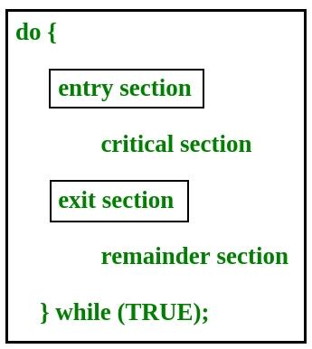
CRITICAL SECTION PROBLEM
Critical section is a code segment that can be accessed by only one process at a time.
Critical section contains shared variables which need to be synchronized to maintain consistency of data variables.

Slide 3
PROCESS SYNCHRONIZATION
It is a procedure that is involved in order to preserve the appropriate order of execution of cooperative processes.
On the basis of synchronization, processes are categorized as one of the following two types:
Independent Process : Execution of one process does not affects the execution of other processes.
Cooperative Process : Execution of one process affects the execution of other processes.
Process synchronization problem arises in the case of Cooperative process also because resources are shared in Cooperative processes.

Slide 4
REQUIREMENTS
Any solution to the critical section problem must satisfy three requirements:
Mutual Exclusion : If a process is executing in its critical section, then no other process is allowed to execute in the critical section.
Progress : If no process is executing in the critical section and other processes are waiting outside the critical section, then only those processes that are not executing in their remainder section can participate in deciding which will enter in the critical section next, and the selection can not be postponed indefinitely.
Bounded Waiting : A bound must exist on the number of times that other processes are allowed to enter their critical sections after a process has made a request to enter its critical section and before that request is granted.

Slide 5
RACE CONDITION
A race condition is a situation that may occur inside a critical section. This happens when the result of multiple thread execution in the critical section differs according to the order in which the threads execute.
Race conditions in critical sections can be avoided if the critical section is treated as an atomic instruction. Also, proper thread synchronization using locks or atomic variables can prevent race conditions.

Slide 6
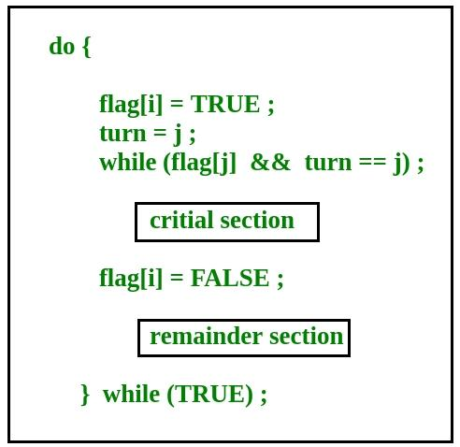
PETERSON’S SOLUTION
Peterson’s Solution is a classical software based solution to the critical section problem.

Slide 7
PETERSON’S SOLUTION
In Peterson’s solution, we have two shared variables:
Boolean flag[i] :Initialized to FALSE, initially no one is interested in entering the critical section
Int turn : The process whose turn is to enter the critical section.
Peterson’s Solution preserves all three conditions :
Mutual Exclusion is assured as only one process can access the critical section at any time.

Slide 8
PETERSON’S SOLUTION
In Peterson’s solution, we have two shared variables:
Boolean flag[i] :Initialized to FALSE, initially no one is interested in entering the critical section
Int turn : The process whose turn is to enter the critical section.
Peterson’s Solution preserves all three conditions :
Mutual Exclusion is assured as only one process can access the critical section at any time.

Slide 9
Test And Set
Test And Set is a hardware solution to the synchronization problem.
In Test And Set, we have a shared lock variable which can take either of the two values, 0 or 1.
0 Unlock
1 Lock

Slide 10
TEST AND SET
Before entering into the critical section, a process inquires about the lock.
If it is locked, it keeps on waiting until it becomes free and if it is not locked, it takes the lock and executes the critical section.
In Test And Set, Mutual exclusion and progress are preserved but bounded waiting cannot be preserved.

Slide 11
INTER PROCESSING COMMUNICATION
Inter-process communication (IPC) is a mechanism that allows processes to communicate with each other and synchronize their actions.
The communication between these processes can be seen as a method of co-operation between them.
Processes can communicate with each other through both:
Shared Memory
Message passing

Slide 12
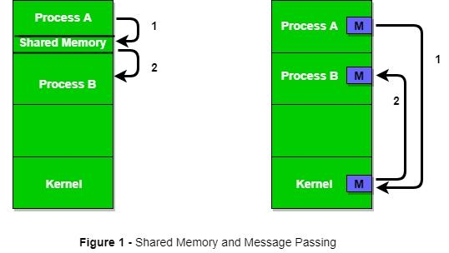
INTER PROCESSING COMMUNICATION
Shared memory and message passing

Slide 13
INTER PROCESS COMMUNICATION
An operating system can implement both methods of communication.
Communication between processes using shared memory requires processes to share some variable, and it completely depends on how the programmer will implement it.
One way of communication using shared memory can be imagined like this:
Suppose process1 and process2 are executing simultaneously, and they share some resources or use some information from another process.

Slide 14
INTER PROCESS COMMUNICATION
Process1 generates information about certain computations or resources being used and keeps it as a record in shared memory.
When process2 needs to use the shared information, it will check in the record stored in shared memory and take note of the information generated by process1 and act accordingly.
Processes can use shared memory for extracting information as a record from another process as well as for delivering any specific information to other processes.

Slide 15
SHARED MEMORY METHOD
Ex: Producer-Consumer problem There are two processes: Producer and Consumer. The producer produces some items and the Consumer consumes that item.
The two processes share a common space or memory location known as a buffer where the item produced by the Producer is stored and from which the Consumer consumes the item if needed.
There are two versions of this problem: the first one is known as the unbounded buffer problem in which the Producer can keep on producing items and there is no limit on the size of the buffer
The second one is known as the bounded buffer problem in which the Producer can produce up to a certain number of items before it starts waiting for Consumer to consume it.

Slide 16
SHARED MEMORY METHOD
We will discuss the bounded buffer problem.
First, the Producer and the Consumer will share some common memory, then the producer will start producing items.
If the total produced item is equal to the size of the buffer, the producer will wait to get it consumed by the Consumer.
Similarly, the consumer will first check for the availability of the item.
If no item is available, the Consumer will wait for the Producer to produce it.
If there are items available, Consumer will consume them

Slide 17
MESSAGE PASSING METHOD
In this method, processes communicate with each other without using any kind of shared memory. If two processes p1 and p2 want to communicate with each other, they proceed as follows:
Establish a communication link (if a link already exists, no need to establish it again
Start exchanging messages using basic primitives. We need at least two primitives:
– send(message, destination) or send(message)
– receive(message, host) or receive(message)

Slide 18
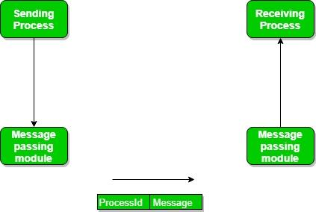
MESSAGING PASSING METHOD
Message passing method

Slide 19
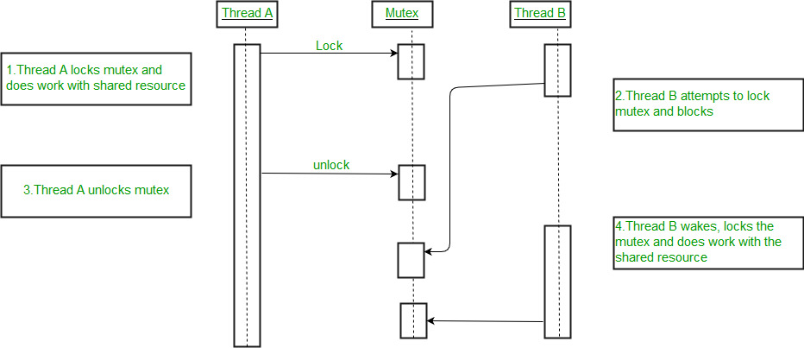
MUTEX LOCKS
A Mutex is a lock that we set before using a shared resource and release after using it. When the lock is set, no other thread can access the locked region of code

Slide 20
SEMAPHORES
Semaphore is simply an integer variable that is shared between threads.
This variable is used to solve the critical section problem and to achieve process synchronization in the multiprocessing environment. Semaphores are of two types:
Binary Semaphore – This is also known as mutex lock. It can have only two values – 0 and 1. Its value is initialized to 1. It is used to implement the solution of critical section problems with multiple processes.
Counting Semaphore – Its value can range over an unrestricted domain. It is used to control access to a resource that has multiple instances.

Slide 21
MUTEX VS SEMAPHORE
Consider the standard producer-consumer problem. Assume, we have a buffer of 4096-byte length.
A producer thread collects the data and writes it to the buffer.
A consumer thread processes the collected data from the buffer.
The objective is, both the threads should not run at the same time.

Slide 22
MUTEX VS SEMAPHORE
Using Mutex:
A mutex provides mutual exclusion, either producer or consumer can have the key (mutex) and proceed with their work. As long as the buffer is filled by the producer, the consumer needs to wait, and vice versa.
At any point of time, only one thread can work with the entire buffer. The concept can be generalized using semaphore.

Slide 23
MUTEX VS SEMAPHORE
Using Semaphore:
A semaphore is A generalized mutex. In lieu of a single buffer, we can split the 4 KB buffer into four 1 KB buffers (identical resources).
A semaphore can be associated with these four buffers. The consumer and producer can work on different buffers at the same time.
This is how we use mutex and semaphore in case of Standard prouducer problem

Slide 24
THANKYOU

